Slide 1
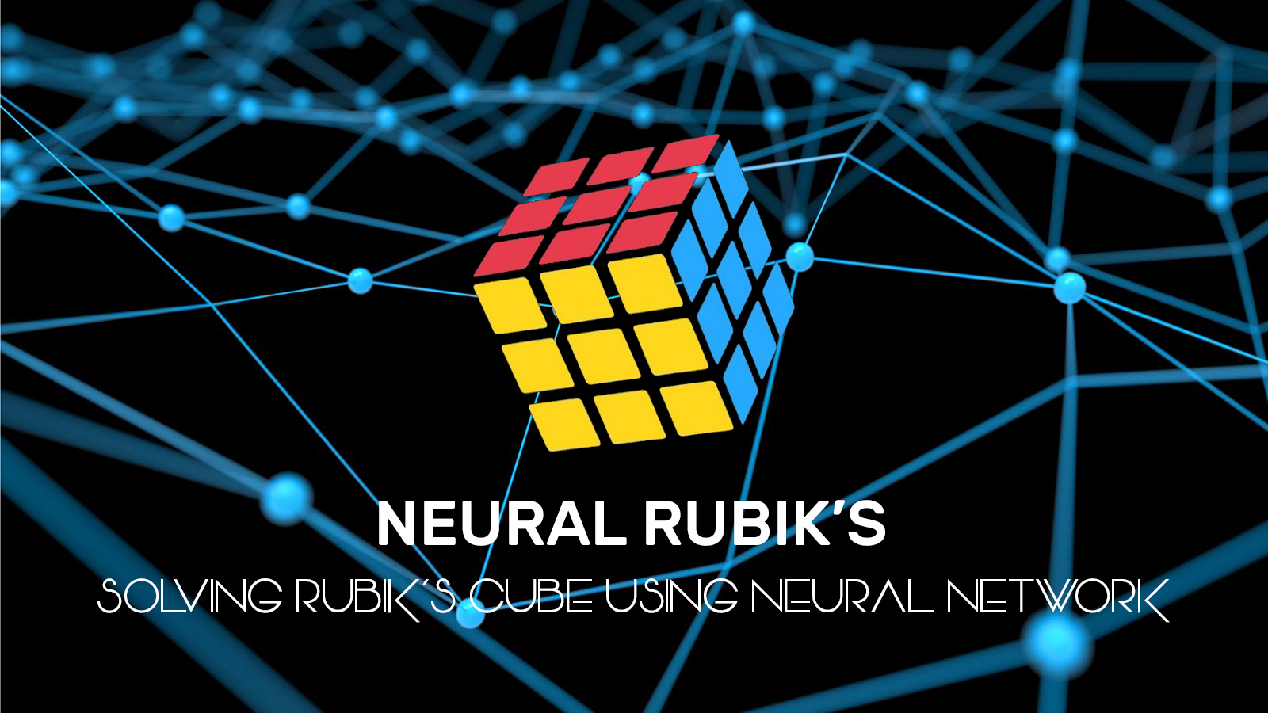
Candidate Name : Gunasegarran Magadevan
Matrix Number : WQD170002
Title : Neural Rubik’s – Solving Rubik’s Cube
Using Neural Network
(Heuristic Learning)

Slide 2
CHAPTER 1 : INTRODUCTION
CHAPTER 2 : LITERATURE REVIEW
CHAPTER 3 : RESEARCH METHODOLOGY
QUESTIONS & ANSWER

Slide 3
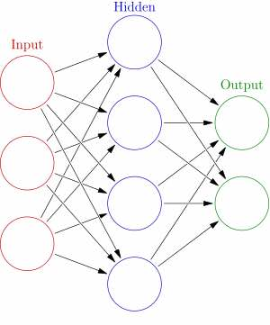
INTRODUCTION
Neural Network
A set of algorithms, modelled loosely after the human brain, that are designed to recognize patterns.
They interpret sensory data through a kind of machine perception, labelling or clustering raw input.
The patterns they recognize are numerical, contained in vectors, into which all real-world data, be it images, sound, text or time series, must be translated.
Heuristic learning
Involving or serving as an aid to learning, discovery, or problem-solving by experimental methods.
Using trial-and-error which can speed up the process of finding a satisfactory solution.
”I have not failed 1000 times, but I have discovered 1000 ways how not to invent the light bulb” - Thomas Edison

Slide 4
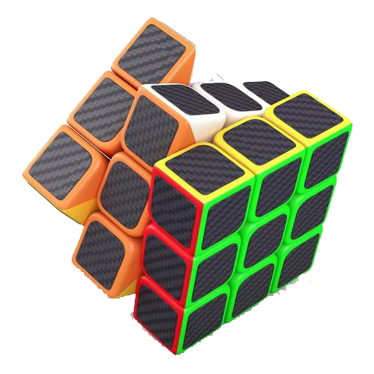
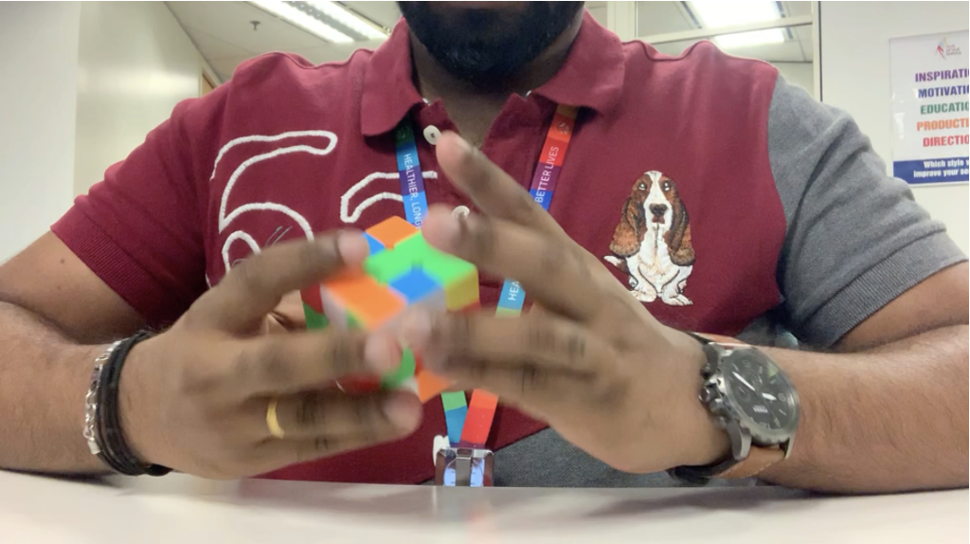
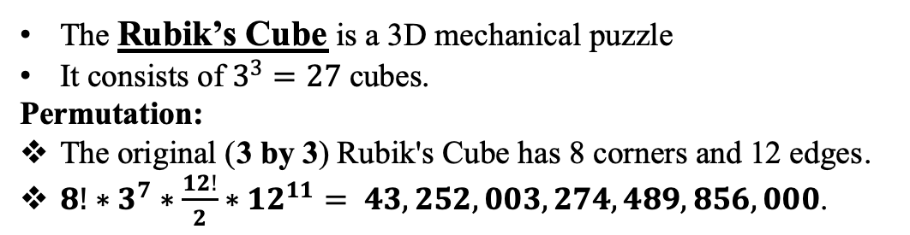
INTRODUCTION
The Rubik’s Cube is a 3D mechanical puzzle
It consists of $3^{3}=27$ cubes.
Permutation:
The original (3 by 3) Rubik's Cube has 8 corners and 12 edges.
$8!∗3^{7}∗\frac{12!}{2}∗{12}^{11}= 43,252,003,274,489,856,000$.
Personal Record
1:15

Slide 5
INTRODUCTION
Research Problem
Implementing neural network approaches to solve the Rubik’s Cube have struggled to succeed without human help and have had to rely on hand-engineered features and group theory to systematically find solutions.
Research
Question
How to obtain a valuable function automatically, so that the whole problem-solving process is free of human knowledge.
Research
Objective
To obtain valuable heuristic functions automatically, so that the whole problem-solving process is free of human knowledge.
Research
Significant
The finding of this research paper is to obtain valuable heuristic functions that the whole problem-solving process is free of human knowledge and as use heuristic algorithm rules that will perform random walks backwards from a goal state and try to learn how far they reached rules are from the goal.
Research Delivery
To prove this research paper and experiment of neural network using heuristic learning is the best choice to solve Rubik’s Cube.
How to use the rules of an algorithm that performs from a goal state and try to learn from the goal how far it can reach the rules.
To use heuristic rules of the algorithm to perform random walks back from the goal state and try to learn how far the goal has been achieved.

Slide 6

LITERATURE REVIEW
Learning | Differences
Pattern Database Learning | PDB is a heuristic method put away as a query table and were applied to permutation problems.
Boosting Learning | Boosting, a machine-learning method that is the observation that finding many rough rules of thumb can be a lot easier than finding a single, highly accurate prediction rule.
Autodidactic Iteration | ADI trains neural system esteem and strategy work through an iterative procedure.
Heuristic Learning | Heuristic learning s a solution that is hoped to be close to the best possible answer, or 'optimal solution'

Slide 7
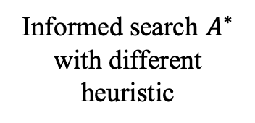
RESEARCH
METHODOLOGY
Informed Search Algorithm
QUANTITATIVE REASEARCH
Informed search $A^{∗}$ with different heuristic
Exploit statistical regularities of the problems

Slide 8
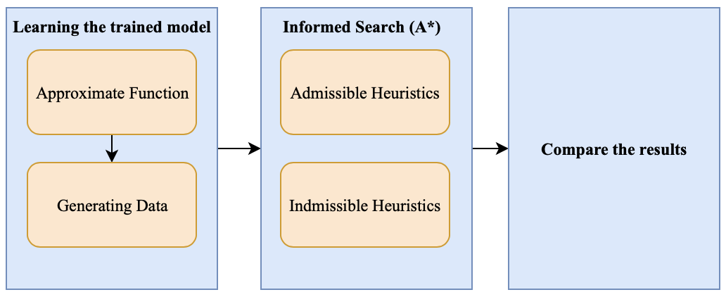
RESEARCH
METHODOLOGY
Informed Search
Algorithm

Slide 9
RESEARCH
METHODOLOGY
Learning the trained model
Approximate Function
Let $C$ be the space of all 3 by 3 of Rubik’s Cube. The aim is to train a model that works closely with $h^{∗}:C →ℕ$ that maps every cube setup to its shortest distance from the target state. To achieve this, it is decided to train a regression model of the Deep Neural Network (DNN) in a supervised learning setup.
Let 𝐶 be the space of all 3 by 3 of Rubik’s Cube. The aim is to train a model that works closely with ℎ^∗:𝐶 →ℕ that maps every cube setup to its shortest distance from the target state. To achieve this, it is decided to train a regression model of the Deep Neural Network (DNN) in a supervised learning setup.
Generating Sample Data
For the estimator training, it is essential to generate examples with a given distance from the objective — data examples of mixed cubes with distanced needed to be generated. In order to do this, went back randomly from an objective state. That provides a cube setup that is long, as it cannot be sure that there are no shorter walks that will produce the same result.
Informed Search
Algorithm

Slide 10
RESEARCH
METHODOLOGY
Informed Search (A*)
Admissible Heuristics
Utilized to assess the expense of achieving the objective state in the heuristic algorithm.
Inadmissible Heuristics
Find the non-optimal path.
Discover an expected ideal way to the objective state from the current state.
By biasing the estimate, it can choose between path cost and search cost.
Informed Search
Algorithm

Slide 11
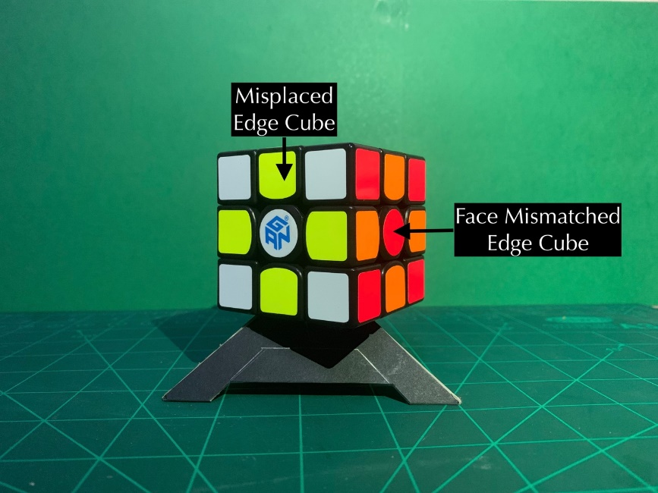
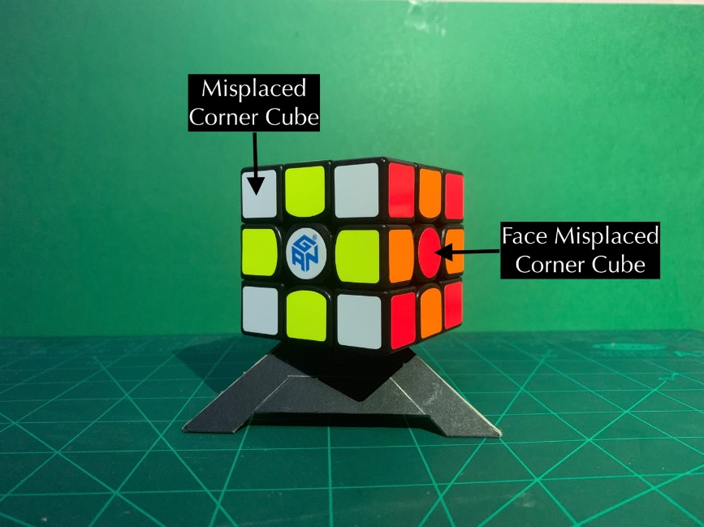
RESEARCH
METHODOLOGY
Informed Search (A*)
Admissible Heuristics
Maximum Misplaced Edges Cubes in Rubik’s Cube Face
Inadmissible Heuristics
Maximum Misplaced Edges and Corner Cubes in Rubik’s Cube Face
Maximum Misplaced Corners Cubes in Rubik’s Cube Face
Maximum and Minimum Misplaced Corner and Edge Cubes in Rubik’s Cube Face
Maximum Misplaced Corner and Maximum Misplaced Edge Cube in Face
Informed Search
Algorithm

Slide 12

QUESTION
&
ANSWER

